Slide 1
Double Linked List and Circular Linked List

Slide 2
Doubly linked list

Slide 3
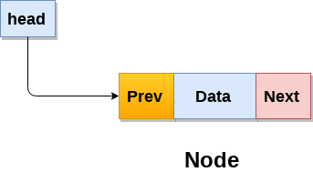
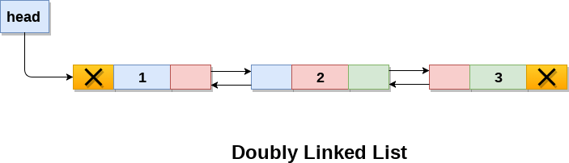
Doubly linked list is a complex type of linked list in which a node contains a pointer to the previous as well as the next node in the sequence.
Therefore, in a doubly linked list, a node consists of three parts: node data, pointer to the next node in sequence (next pointer) , pointer to the previous node (previous pointer).

Slide 4
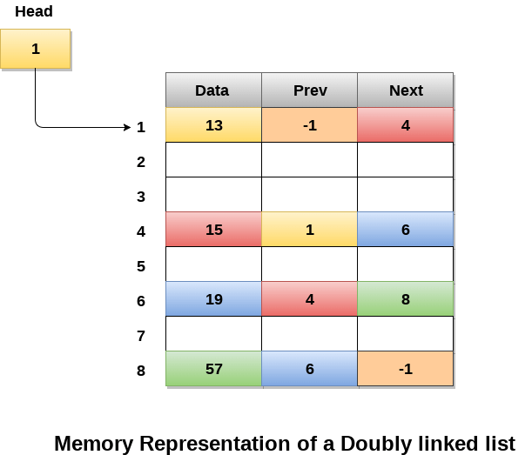
struct node
{
struct node *prev;
int data;
struct node *next;
}
Memory Representation of a doubly linked list
-1 indicates NULL

Slide 5
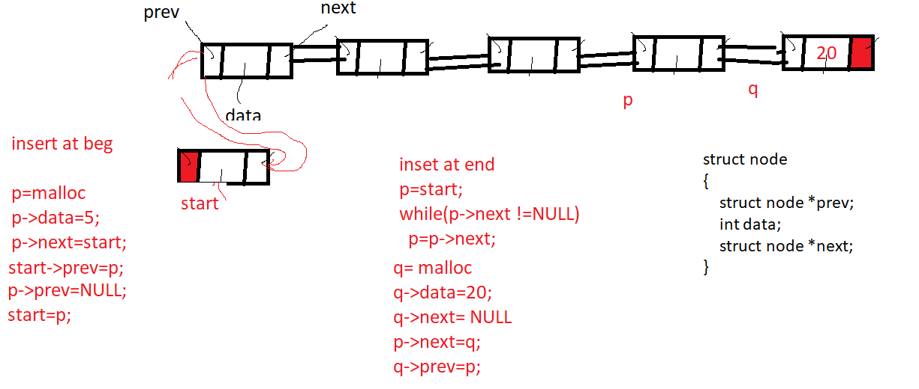

Slide 6
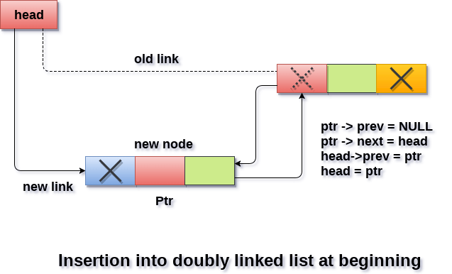
Insertion in doubly linked list at beginning
Algorithm :
Step 1: SET NEW_NODE = PTR
Step 2: SET NEW_NODE -> PREV = NULL
Step 3: SET NEW_NODE -> NEXT = START
Step 4: SET head -> PREV = NEW_NODE
Step 5: SET head = NEW_NODE
Step 6: EXIT

Slide 7
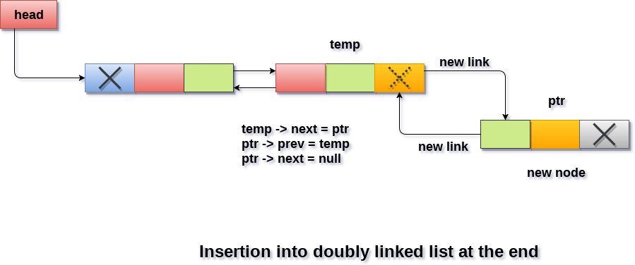
Insertion in doubly linked list at the end
Algorithm
Step 1: SET NEW_NODE = PTR
Step 2: SET NEW_NODE -> DATA = VAL
Step 3: SET NEW_NODE -> NEXT = NULL
Step 4: SET TEMP = START
Step 5: Repeat Step 6 while TEMP -> NEXT != NULL
Step 6: SET TEMP = TEMP -> NEXT
[END OF LOOP]
Step 7: SET TEMP -> NEXT = NEW_NODE
Step 8: SET NEW_NODE -> PREV = TEMP
Step 9: EXIT

Slide 8
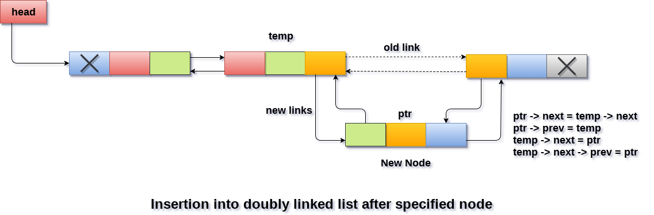
Insertion in doubly linked list after Specified node
Algorithm
Step 1: SET NEW_NODE = PTR
Step 2: SET PTR = PTR -> NEXT
Step 3: SET NEW_NODE -> DATA = VAL
Step 4: SET TEMP = START
Step 5: SET I = 0
Step 6: REPEAT 7 to 9
Step 7: SET TEMP = TEMP -> NEXT
STEP 8: IF TEMP = NULL // no further node
STEP 9: WRITE "LESS THAN DESIRED NO. OF ELEMENTS"
GOTO STEP 14
[END OF IF]
[END OF LOOP]
Step 10: SET NEW_NODE -> NEXT = TEMP -> NEXT
Step 11: SET NEW_NODE -> PREV = TEMP
Step 12 : SET TEMP -> NEXT -> PREV = NEW_NODE
Step 13 : SET TEMP -> NEXT = NEW_NODE
Step 14: EXIT

Slide 9
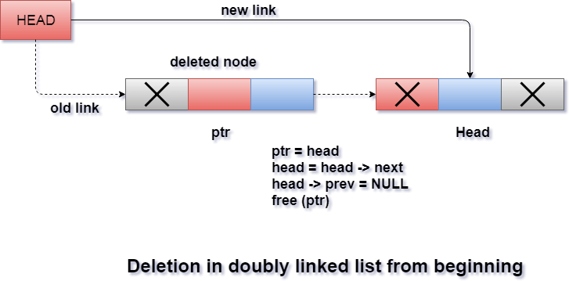
Deletion at beginning
Algorithm
STEP 1: IF HEAD = NULL
WRITE UNDERFLOW
GOTO STEP 6
STEP 2: SET PTR = HEAD
STEP 3: SET HEAD = HEAD → NEXT
STEP 4: SET HEAD → PREV = NULL
STEP 5: FREE PTR
STEP 6: EXIT

Slide 10
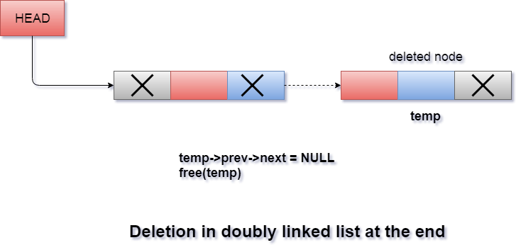
Deletion in doubly linked list at the end
ALGORITHM
Step 1: IF HEAD = NULL
Write UNDERFLOW
Go to Step 7
[END OF IF]
Step 2: SET TEMP = HEAD
Step 3: REPEAT STEP 4 WHILE TEMP->NEXT != NULL
Step 4: SET TEMP = TEMP->NEXT
[END OF LOOP]
Step 5: SET TEMP ->PREV-> NEXT = NULL
Step 6: FREE TEMP
Step 7: EXIT

Slide 11
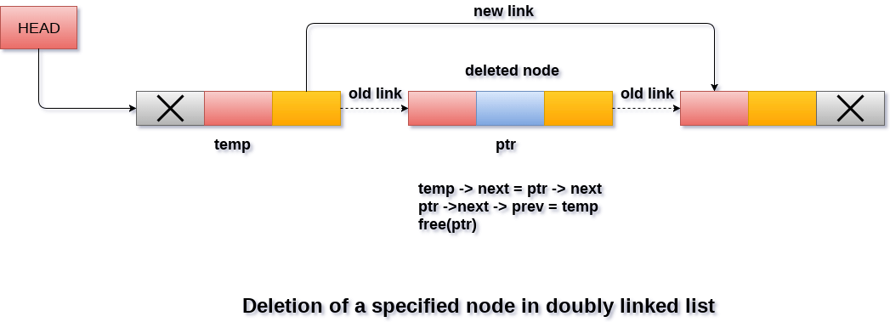
Deletion in doubly linked list after the specified node
Algorithm
Step 1: IF HEAD = NULL
Write UNDERFLOW
Go to Step 9
[END OF IF]
Step 2: SET TEMP = HEAD
Step 3: Repeat Step 4 while TEMP -> DATA != ITEM
Step 4: SET TEMP = TEMP -> NEXT
[END OF LOOP]
Step 5: SET PTR = TEMP -> NEXT
Step 6: SET TEMP -> NEXT = PTR -> NEXT
Step 7: SET PTR -> NEXT -> PREV = TEMP
Step 8: FREE PTR
Step 9: EXIT

Slide 12
CIRCULAR LINKED LIST

Slide 13
Why Circular?
In a singly linked list, for accessing any node of linked list, we start traversing from the first node.
If we are at any node in the middle of the list, then it is not possible to access nodes that precede the given node.
This problem can be solved by slightly altering the structure of singly linked list.
In a singly linked list, next part (pointer to next node) is NULL, if we utilize this link to point to the first node then we can reach preceding nodes.

Slide 14
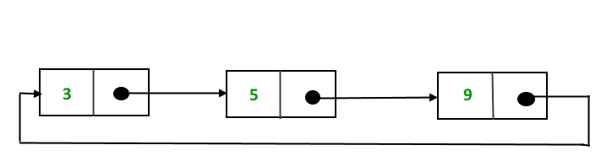
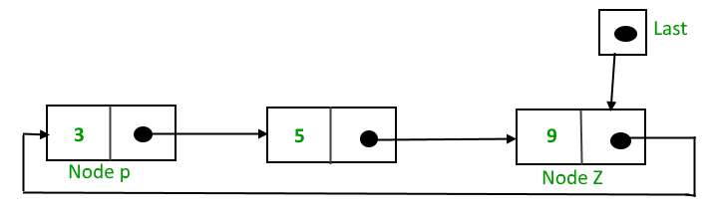
The pointer last points to node Z and last -> next points to node P.

Slide 15
Why have we taken a pointer that points to the last node instead of first node ?
For insertion of node in the beginning we need traverse the whole list.
Also, for insertion at the end, the whole list has to be traversed.
If instead of start pointer we take a pointer to the last node then in both the cases there won’t be any need to traverse the whole list.
So insertion in the beginning or at the end takes constant time irrespective of the length of the list.

Slide 16
Insertion
A node can be added in three ways:
Insertion in an empty list
Insertion at the beginning of the list
Insertion at the end of the list
Insertion in between the nodes

Slide 17
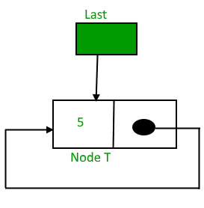

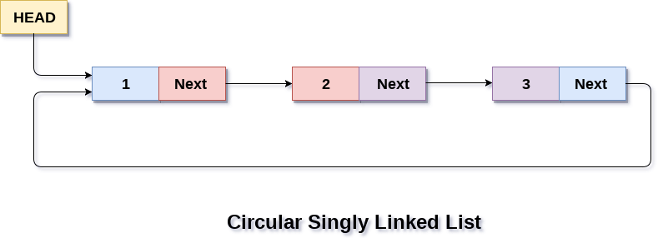

Slide 18
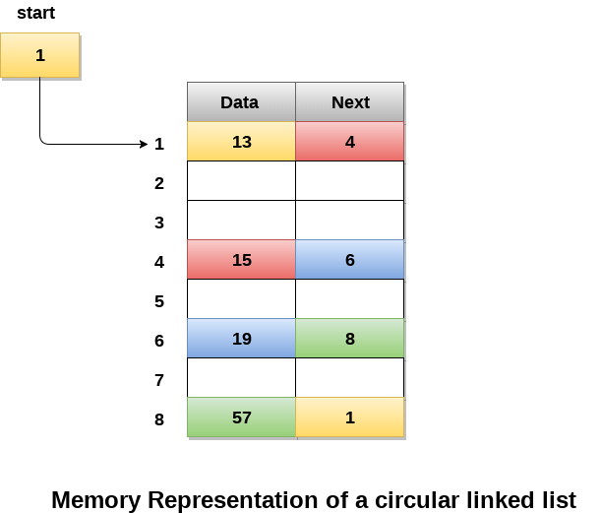
Memory Representation of CLL

Slide 19
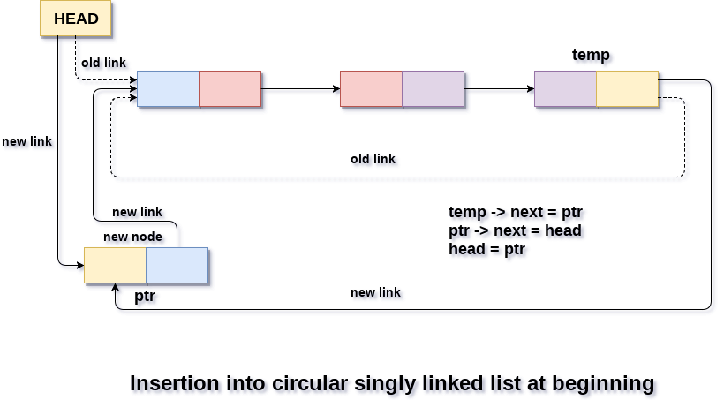
Insertion into circular singly linked list at beginning

Slide 20
Algorithm
Step 1: IF PTR = NULL
Write OVERFLOW
Go to Step 11
[END OF IF]
Step 2: SET NEW_NODE = PTR
Step 3: SET PTR = PTR -> NEXT
Step 4: SET NEW_NODE -> DATA = VAL
Step 5: SET TEMP = HEAD
Step 6: Repeat Step 7 while TEMP -> NEXT != HEAD
Step 7: SET TEMP = TEMP -> NEXT
[END OF LOOP]
Step 8: SET NEW_NODE -> NEXT = HEAD
Step 9: SET TEMP → NEXT = NEW_NODE
Step 10: SET HEAD = NEW_NODE
Step 11: EXIT

Slide 21
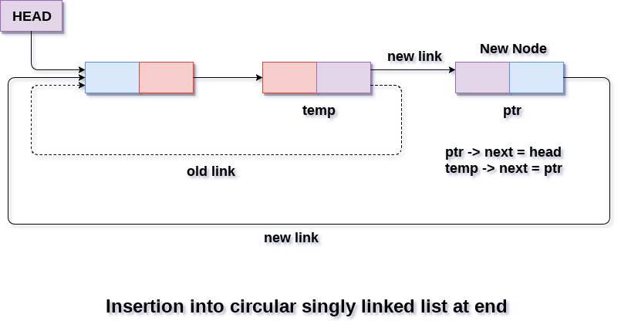
Insertion into circular singly linked list at the end

Slide 22
Algorithm
Step 1: IF PTR = NULL
Write OVERFLOW
Go to Step 1
[END OF IF]
Step 2: SET NEW_NODE = PTR
Step 3: SET PTR = PTR -> NEXT
Step 4: SET NEW_NODE -> DATA = VAL
Step 5: SET NEW_NODE -> NEXT = HEAD
Step 6: SET TEMP = HEAD
Step 7: Repeat Step 8 while TEMP -> NEXT != HEAD
Step 8: SET TEMP = TEMP -> NEXT
[END OF LOOP]
Step 9: SET TEMP -> NEXT = NEW_NODE
Step 10: EXIT

Slide 23
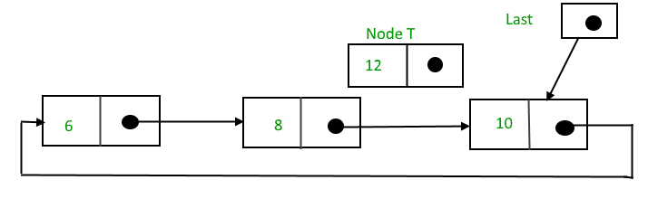
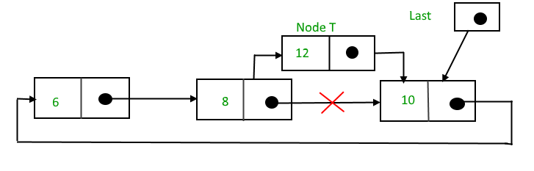
Insertion in between the nodes To Insert a node in between the two nodes, follow these step: 1. Create a node, say T. 2. Search the node after which T need to be insert, say that node be P. 3. Make T -> next = P -> next; 4. P -> next = T. Suppose 12 need to be insert before node having value 10,

Slide 24
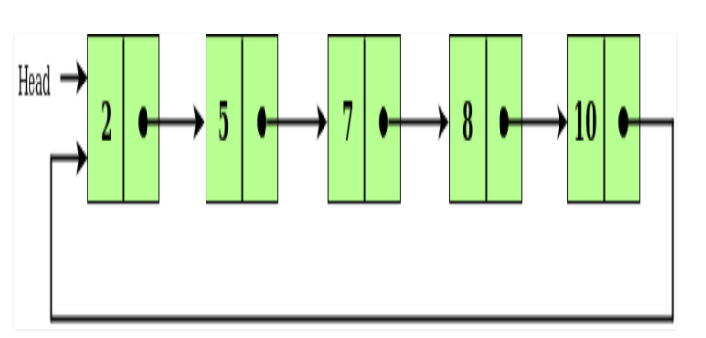
Deletion in CLL
given a node and our task is to delete that node from the circular linked list.

Slide 25
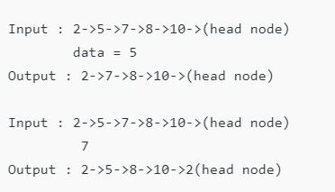
Examples:
Algorithm
Case 1: List is empty.
If the list is empty we will simply return.

Slide 26
Deletion in circular singly linked list at beginning
The list is Empty
If the list is empty then the condition head == NULL will become true, in this case, we just need to print underflow on the screen and make exit.
if(head == NULL)
{
printf("\nUNDERFLOW");
return;
}

Slide 27
The list contains single node
If the list contains single node then, the condition head → next == head will become true. In this case, we need to delete the entire list and make the head pointer free.
if(head->next == head)
{
head = NULL;
free(head);
}

Slide 28
The list contains more than one node
we need to traverse the list by using the pointer ptr to reach the last node of the list. This will be done by using the following statements.
ptr = head;
while(ptr -> next != head)
ptr = ptr -> next;
At the end of the loop,
ptr->next = head->next;
free(head);

Slide 29
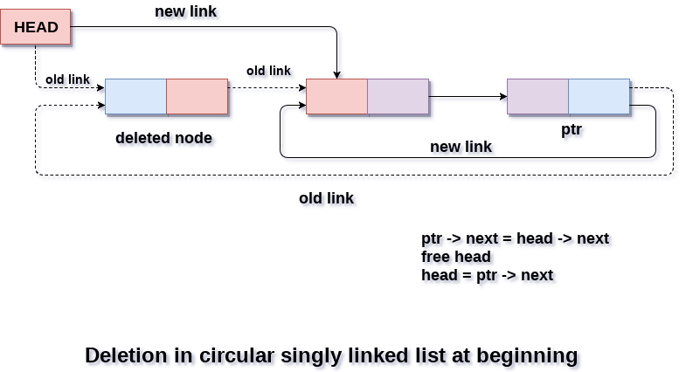

Slide 30
Algorithm
Step 1: IF HEAD = NULL
Write UNDERFLOW
Go to Step 8
[END OF IF]
Step 2: SET PTR = HEAD
Step 3: Repeat Step 4 while PTR → NEXT != HEAD
Step 4: SET PTR = PTR → next
[END OF LOOP]
Step 5: SET PTR → NEXT = HEAD → NEXT
Step 6: FREE HEAD
Step 7: SET HEAD = PTR → NEXT
Step 8: EXIT

Slide 31
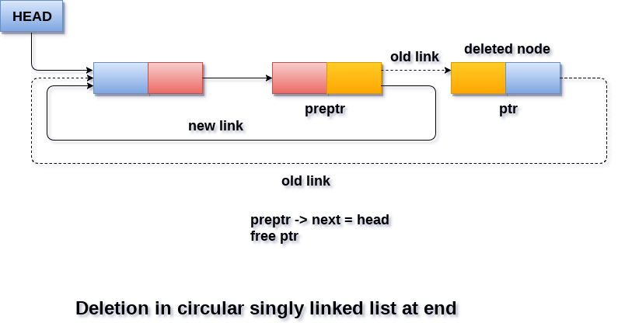
Deletion in Circular singly linked list at the end

Slide 32
the list contains single element
if(head->next == head)
{
head = NULL;
free(head);
}
the list contains more than one element
ptr = head;
while(ptr ->next != head)
{
preptr=ptr;
ptr = ptr->next;
}
we need to make just one more pointer adjustment. We need to make the next pointer of preptr point to the next of ptr (i.e. head) and then make pointer ptr free.
preptr->next = ptr -> next;
free(ptr);

Slide 33
Algorithm
Step 1: IF HEAD = NULL
Write UNDERFLOW
Go to Step 8
[END OF IF]
Step 2: SET PTR = HEAD
Step 3: Repeat Steps 4 and 5 while PTR -> NEXT != HEAD
Step 4: SET PREPTR = PTR
Step 5: SET PTR = PTR -> NEXT
[END OF LOOP]
Step 6: SET PREPTR -> NEXT = HEAD
Step 7: FREE PTR
Step 8: EXIT

Slide 34
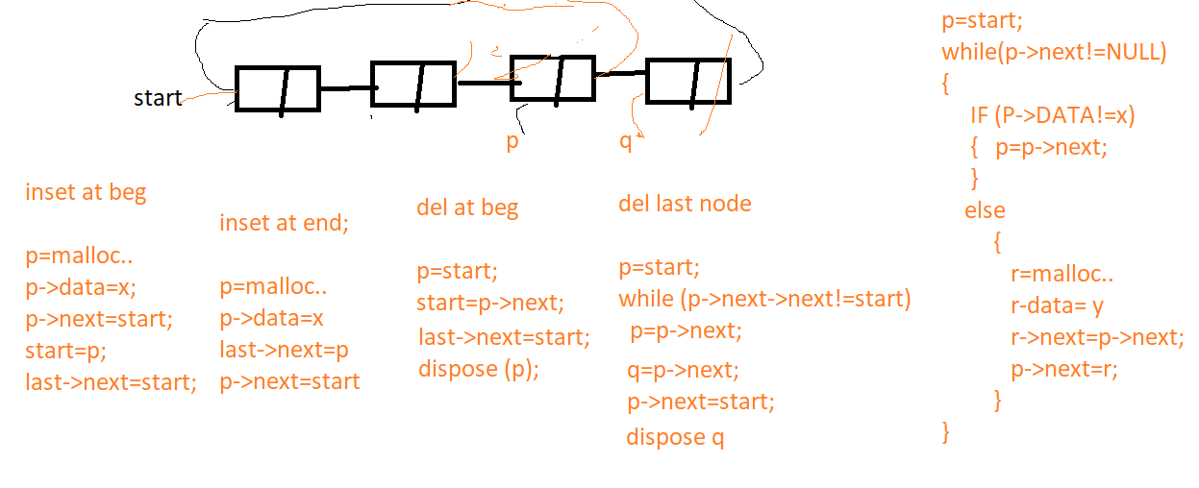
Inset at given position

Slide 35
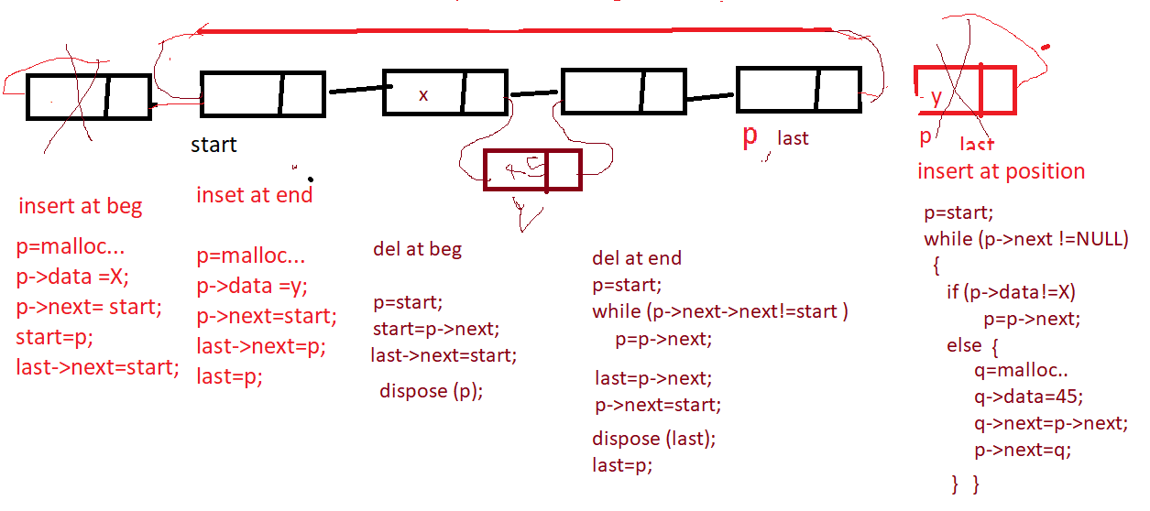

Slide 36
Searching in circular singly linked list
Algorithm
Step 1: SET PTR = HEAD
Step 2: Set I = 0
STEP 3: IF PTR = NULL
WRITE "EMPTY LIST"
GOTO STEP 8
END OF IF
STEP 4: IF HEAD → DATA = ITEM
WRITE i+1 RETURN [END OF IF]
STEP 5: REPEAT STEP 5 TO 7 UNTIL PTR->next != head
STEP 6: IF ptr → data = item
write i+1
RETURN
End of IF
STEP 7: I = I + 1
STEP 8: PTR = PTR → NEXT
[END OF LOOP]
STEP 9: EXIT

Slide 37
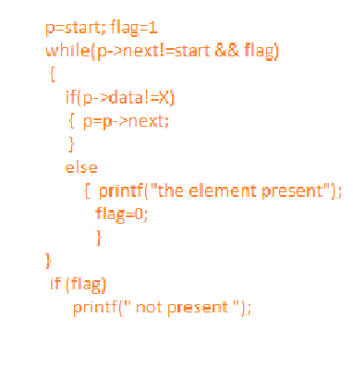
Searching algorithm

Slide 38
Traversing in Circular Singly linked list
Traversing in circular singly linked list can be done through a loop. Initialize the temporary pointer variable temp to head pointer and run the while loop until the next pointer of temp becomes head.
Algorithm
STEP 1: SET PTR = HEAD
STEP 2: IF PTR = NULL
WRITE "EMPTY LIST"
GOTO STEP 8
END OF IF
STEP 4: REPEAT STEP 5 AND 6
UNTIL PTR → NEXT != HEAD
STEP 5: PRINT PTR → DATA
STEP 6: PTR = PTR → NEXT
[END OF LOOP]
STEP 7: PRINT PTR→ DATA
STEP 8: EXIT

Slide 39
// C program to delete a given key from linked list.
#include <stdio.h>
#include <stdlib.h>
struct Node {
int data;
struct Node* next;
};
// Function to insert a node at the beginning of a Circular linked list
void push(struct Node** head_ref, int data)
{
// Create a new node and make head as next of it.
struct Node* ptr1 = (struct Node*)malloc(sizeof(struct Node));
ptr1->data = data;
ptr1->next = *head_ref;
/* If linked list is not NULL then set the next of last node */
if (*head_ref != NULL) {
// Find the node before head and update
// next of it.
struct Node* temp = *head_ref;
while (temp->next != *head_ref)
temp = temp->next;
temp->next = ptr1;
}
else
ptr1->next = ptr1; /*For the first node */
*head_ref = ptr1;
}

Slide 40
/* Function to print nodes in a given circular linked list */
void printList(struct Node* head)
{
struct Node* temp = head;
if (head != NULL) {
do {
printf("%d ", temp->data);
temp = temp->next;
} while (temp != head);
}
printf("\n");
}

Slide 41
// Check if node is only node
if (curr->next == head)
{ head = NULL;
free(curr);
return;
}
// If more than one node, check if it is first node
if (curr == head)
{ prev = head;
while (prev->next != head)
prev = prev->next;
head = curr->next;
prev->next = head;
free(curr);
}
// check if node is last node
else if (curr->next == head && curr == head)
{ prev->next = head;
free(curr);
}
else
{ prev->next = curr->next;
free(curr);
} }
/* Function to delete a given node from the list */
void deleteNode(struct Node* head, int key)
{
if (head == NULL)
return;
// Find the required node
struct Node *curr = head, *prev;
while (curr->data != key)
{
if (curr->next == head)
{
printf("\nGiven node is not found"
" in the list!!!");
break;
}
prev = curr;
curr = curr->next;
}

Slide 42
int main()
{ /* Initialize lists as empty */
struct Node* head = NULL;
/* Created linked list will be 2->5->7->8->10 */
push(&head, 2);
push(&head, 5);
push(&head, 7);
push(&head, 8);
push(&head, 10);
printf("List Before Deletion: ");
printList(head);
deleteNode(head, 7);
printf("List After Deletion: ");
printList(head);
return 0;
}
Output:
List Before Deletion: 10 8 7 5 2
List After Deletion: 10 8 5 2

